Slide 1

Dr.B.R.AMBEDKAR UNIVERSITY COLLEGE OF ENGINEERING, ETCHERLA SRIKAKULAM
DEPARTMENT OF ELECTRONICS & COMMUNICATION ENGINEERING
PRESENTED BY : BATCH - 07
GUIDENCE BY :
G. BHARATH - 2182951021
P. LASYA VARDHINI -2182951040
Y.NAGA.UDAY KIRAN -2182951066
D.TEJESWARA RAO -2182951014
Mrs. CH. SRAVANI
[MTECH]
ASSIT.PROFESSOR
DEPT OF ECE

Slide 2

SENSORS-ENHANCED MOBILITY CANE
INTERNET OF THINGS (IOT)
MINI PROJECT

Slide 3
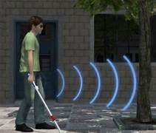
ABSTRACT :
For individuals with visual impairments, navigation in unfamiliar or complex environments can present significant challenges and safety risks. This project introduces a smart blind stick system powered by Arduino and equipped with ultrasonic sensors, designed to Enhance mobility and independence for visually impaired users. The ultrasonic sensors continuously measure distances to detect nearby obstacles, with real-time feedback provided through vibrations or auditory alerts to warn the user. By integrating this sensor-based approach, the smart stick provides a reliable, user-friendly, and cost-effective tool to improve situational awareness and prevent accidents. This assistive technology aims to promote a safer, more autonomous lifestyle for visually impaired individuals.

Slide 4
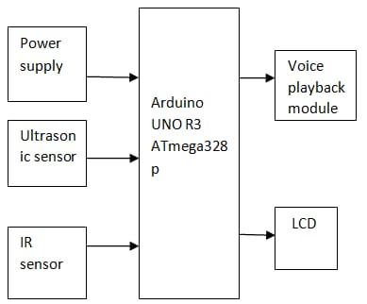
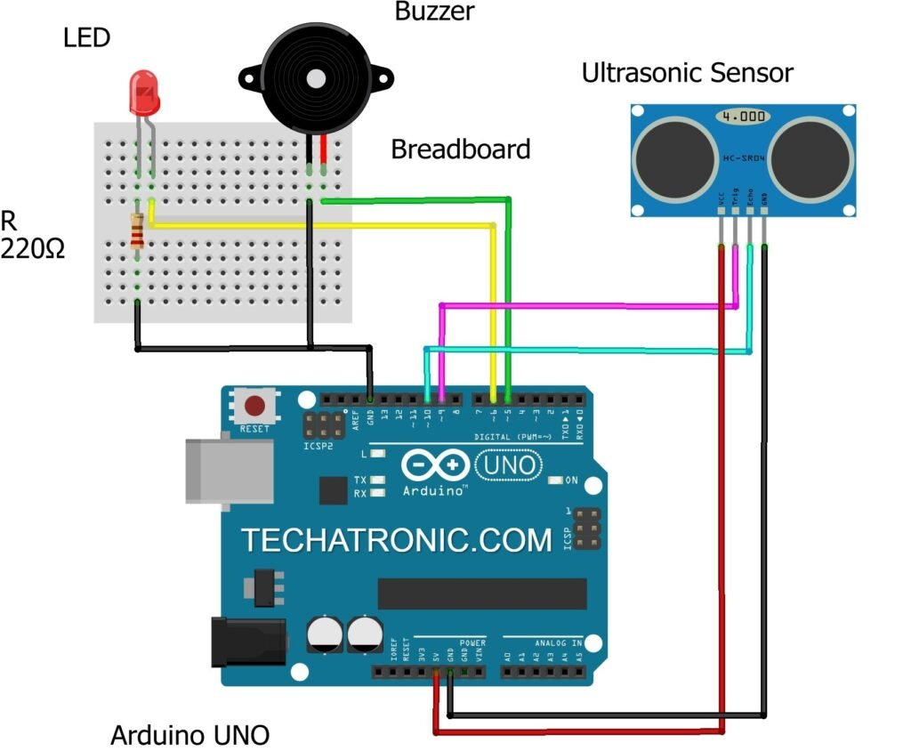
BLOCK DIAGRAM
ARDUNIO
UNO

Slide 5
KEY POINTS :
Enhanced Obstacle Detection: Smart blind sticks utilize advanced sensors like ultrasonic and infrared to detect obstacles beyond the reach of traditional canes, providing early warnings to users.
Additional Features: Smart blind sticks may include features like vibration alerts, object recognition, and even connectivity to smartphones for additional functionalities.
Improved Safety: By providing timely alerts and information, smart blind sticks significantly reduce the risk of accidents and collisions, promoting safer mobility for visually impaired individuals.
Increased Independence: These devices empower visually impaired people to navigate their surroundings with greater confidence and autonomy, reducing reliance on assistance and enhancing their quality of life.

Slide 6
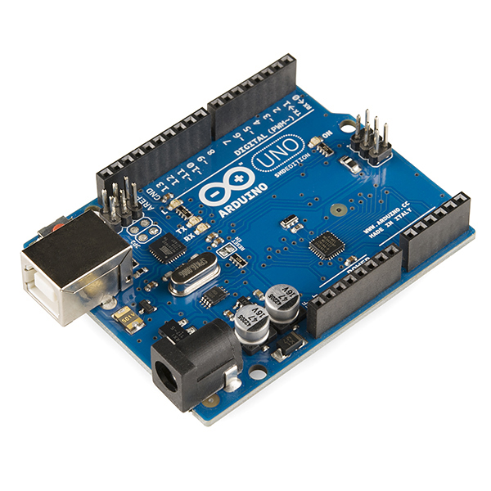
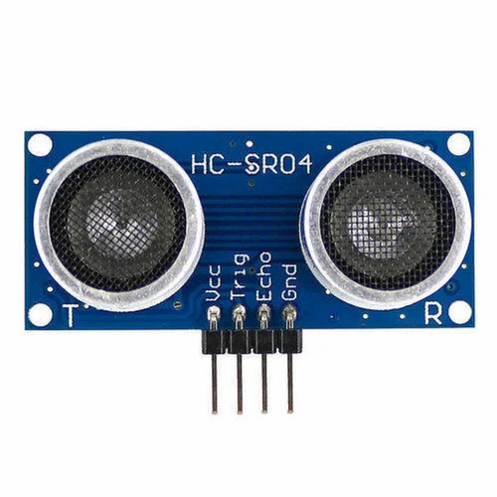
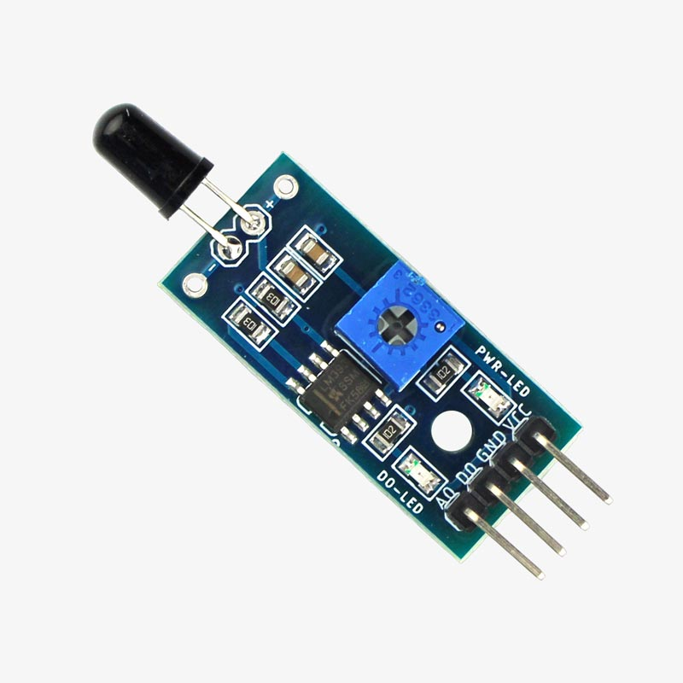
METHODOLOGY :
Microcontroller (e.g., Arduino): Central processor that gathers sensor data, activates outputs, and manages communication.​ To build low-cost scientific instruments, to prove chemistry and physics principles, or to get started with programming and robotics
Ultrasonic Sensor: Detects obstacles by emitting sound waves. Alerts the microcontroller if objects are within range.​ Can measure the distance to a wide range of objects regardless of shape, color or surface texture.
Infrared (IR) Sensor: Detects nearby or ground-level objects, adding precision for close-range obstacles.​ motion detectors, which are used in building services to switch on lamps or in alarm systems to detect unwelcome guests

Slide 7
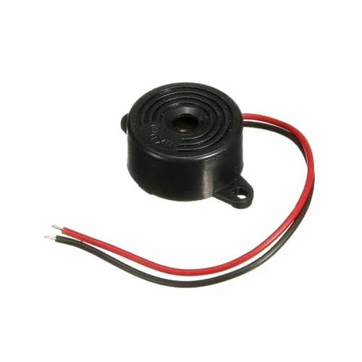
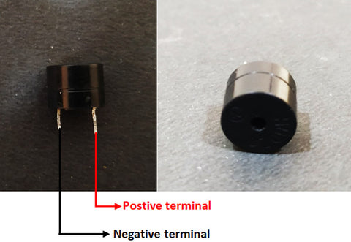
Provides auditory alerts, like “obstacle ahead,” for additional guidance
train and confirmation of user input such as a mouse click or keystroke.
Vibration motors are technical devices that generate and transmit mechanical vibrations by supplying energy.

Slide 8
REFERENCE :
World Health Organization, “Visual Impairment and Blindness,” Fact sheet N “282”, Oct 2014. ​
National Disability Policy: A Progress Report – October 2014, National Council on Disability, Oct 2014.​
T. Terlau and W. M. Penrod, "KSonar Curriculum Handbook", Available from: http://www.aph.org/manuals/ksonar.pdf, June 2008.​
L. Whitney, "Smart cane to help blind navigate", Available from: "http://news.cnet.com/8301-17938\_105-10302499-1.html", 2009.​
J.M. Hans du Buf, J. Barroso, JoJo M.F. Rodrigues, H.Paredes, M. Farra jota, H. Fernandes, J. Jos, V. Teixeira, M. Saleiro.”The Smart Vision Navigation Prototype for Blind Users”. International Journal of Digital Content Technology and its Applications, Vol.5 No .5, pp. 351 – 361, May 2011.​
I. Ulrich, and J. Bornstein, “The guide cane-Applying mobile robot technologies to assist the visually impaired,” IEEE Transaction on Systems, Man, and Cybernetics-Part A: Systems and Humans, vol. 31, no. 2, pp. 131-136, 2001.​
P. Meijer, “An Experimental System for Auditory Image Representations,” IEEE Transactions on Biomedical Engineering, vol.39, no 2, pp. 112-121, Feb 1992. ​

Slide 9
THANK YOU

